Slide 1



Unleashing AutoML for Talent Management ATS and HRIS Data
Ashutosh Singh
Rohit Meena
EAI 6980: - Capstone
Prof. Mimoza Dimodugno

Slide 2

Table of Contents
Introduction
Business Problem and question for Analysis
Data Exploration & Research
Methodology Tools and Technology
Model Building
Conclusion & Future Work

Slide 3
Introduction
Project
Project Aims: -
Understand
Understand the patterns in ATS (Applicant Tracking System) and HRIS (Human Resources Information System) data
Explore
Explore the different types of information captured, including candidate profiles, employment history, performance evaluations, training records etc.
Merge
Merge datasets from different sources.
Identify
Identify the key variables that influence hiring decisions and impact the success of candidate selection.
Develop
Develop a predictive model to predict the hiring of a candidate based on various factors.
Determine
Determine which factors have the most significant influence on successful hiring decisions.
Utilize
Utilize Automated Machine Learning (AutoML) techniques to automate the model development and optimization process.
Harness
Harness the power of AutoML to identify the best machine learning algorithms, feature selection methods, and hyperparameter configurations.
Sampling
Use SMOTE technique to handle imbalance dataset.

Slide 4

Business Problems and Questions for Analysis
PROBLEM STATEMENT
Hired Status Prediction (Classification)
Salary Prediction (Regression)
Job Change Reason (Classification)
Job Role Prediction (Classification)
Questions for Analysis
Which state exhibits both a high volume of job openings and a strong success rate in terms of successfully hired candidates?
What is the most cited reason for job changes among employees?
How does the average annual salary vary based on years of experience?
Which countries have the highest job demand?
Which cities are the most popular for job seekers?
What are the top 10 industries with the highest number of companies?

Slide 5
Data Exploration and Research
1.) Dataset 1: - ATS Master table
Candidate’s information - Name, University, Degree, Previous Employer, Salary Expectation, Hired Status, Job Location
2.) Dataset 2: - HRIS Master table - Historical Data
Employee Historical Data: - Job Role ID, YOB, Location
3.) Dataset 3: - Company Master Table - Combined ATS & HRS Data
Demographical location: - State, Country, Zip
4.) Dataset 4: - Company LinkedIn Master Table
Company Information & Combined data: - Company size, country, location

Slide 6
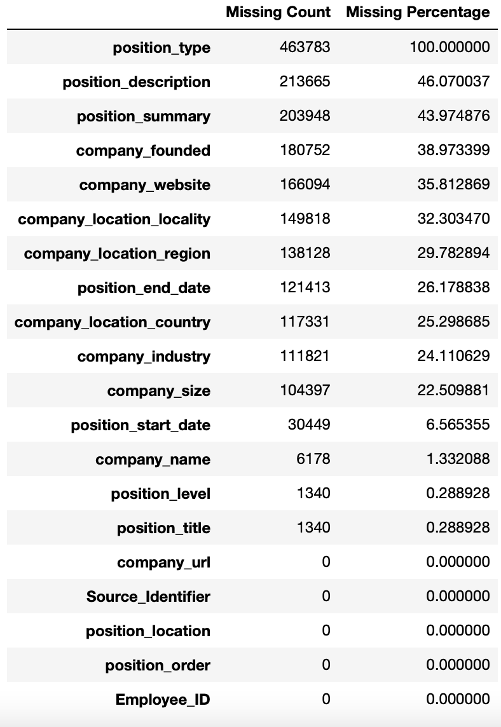
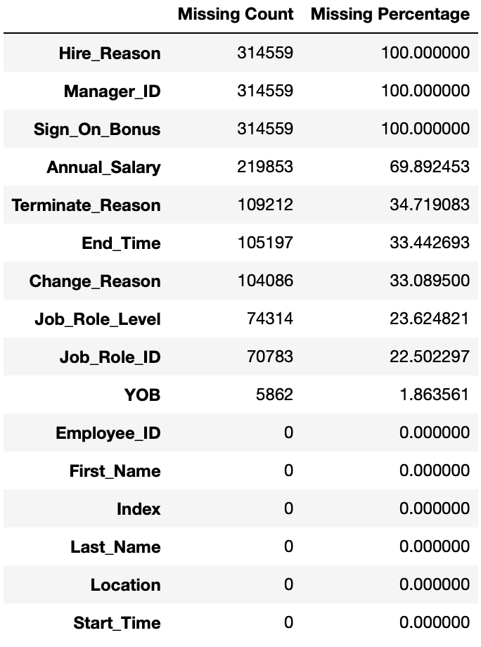
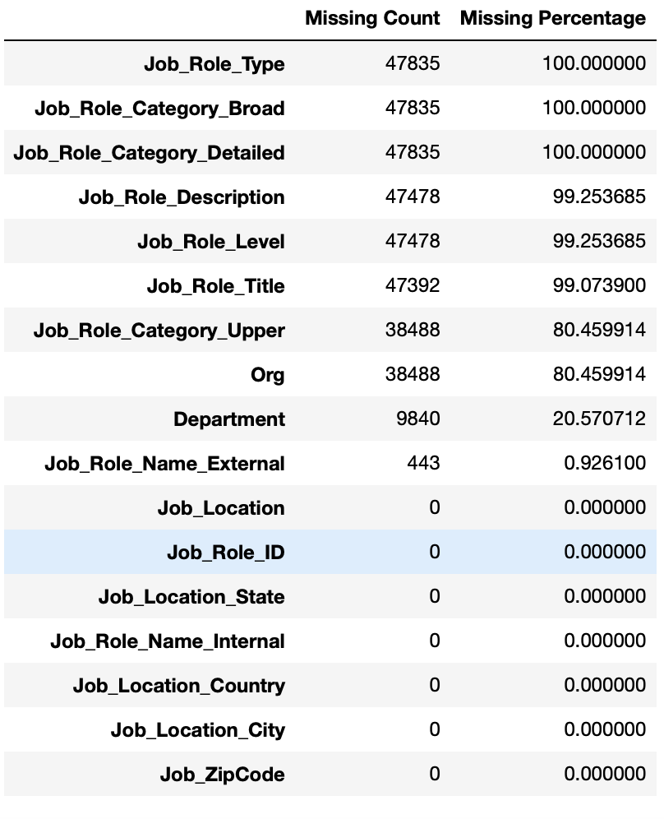
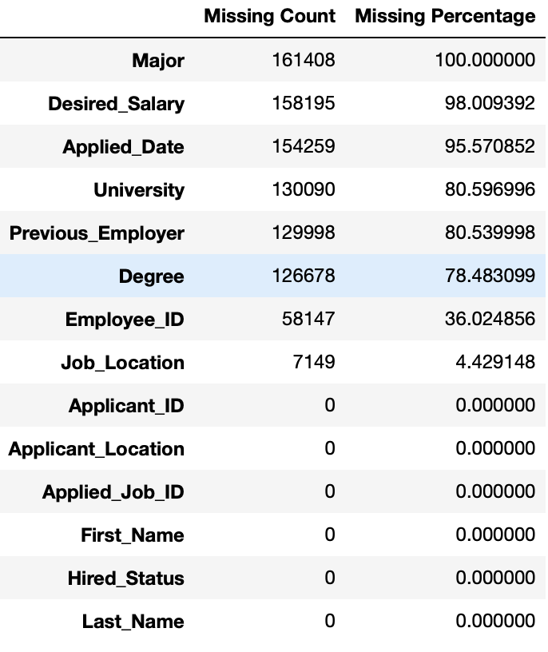
Data Cleaning

Slide 7
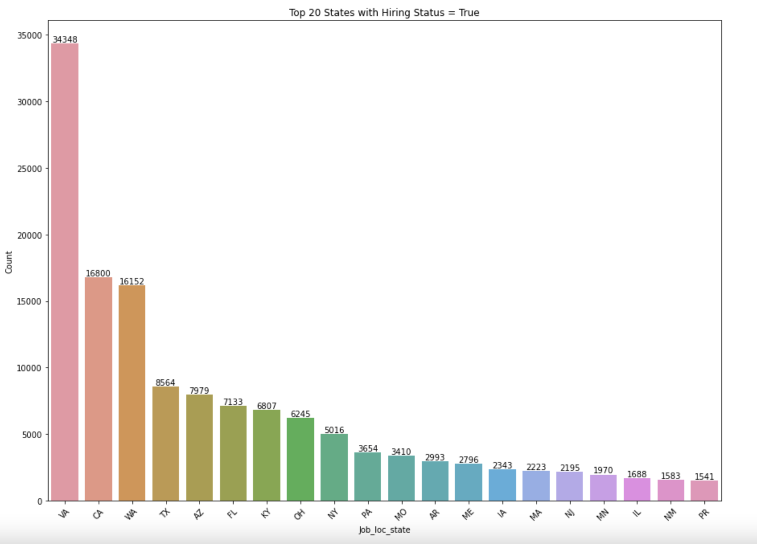
Exploratory Data Analysis
Which state exhibits both a high volume of job openings and a strong success rate in terms of successfully hired candidates?

Slide 8
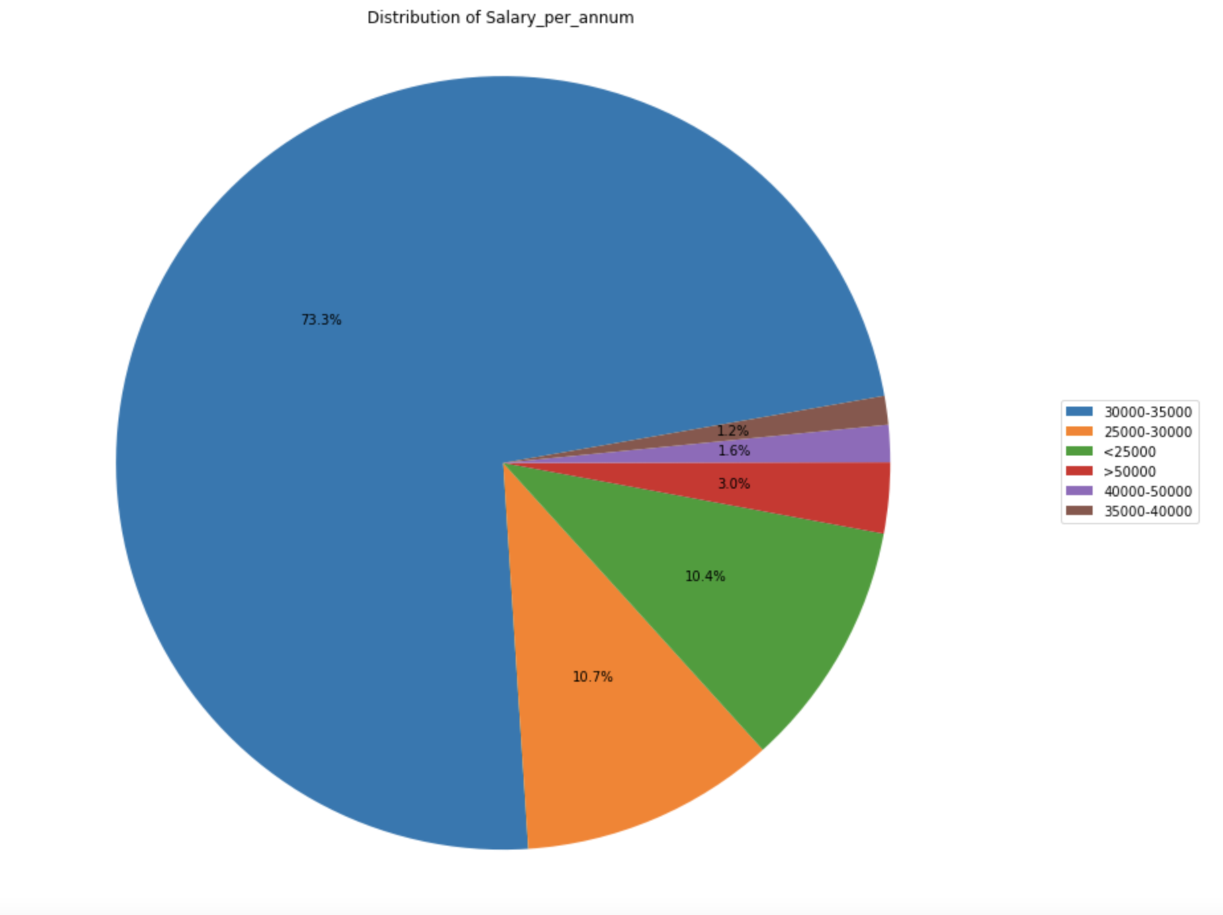
Exploratory Data Analysis
What is the overall distribution of salaries across the entire population?

Slide 9
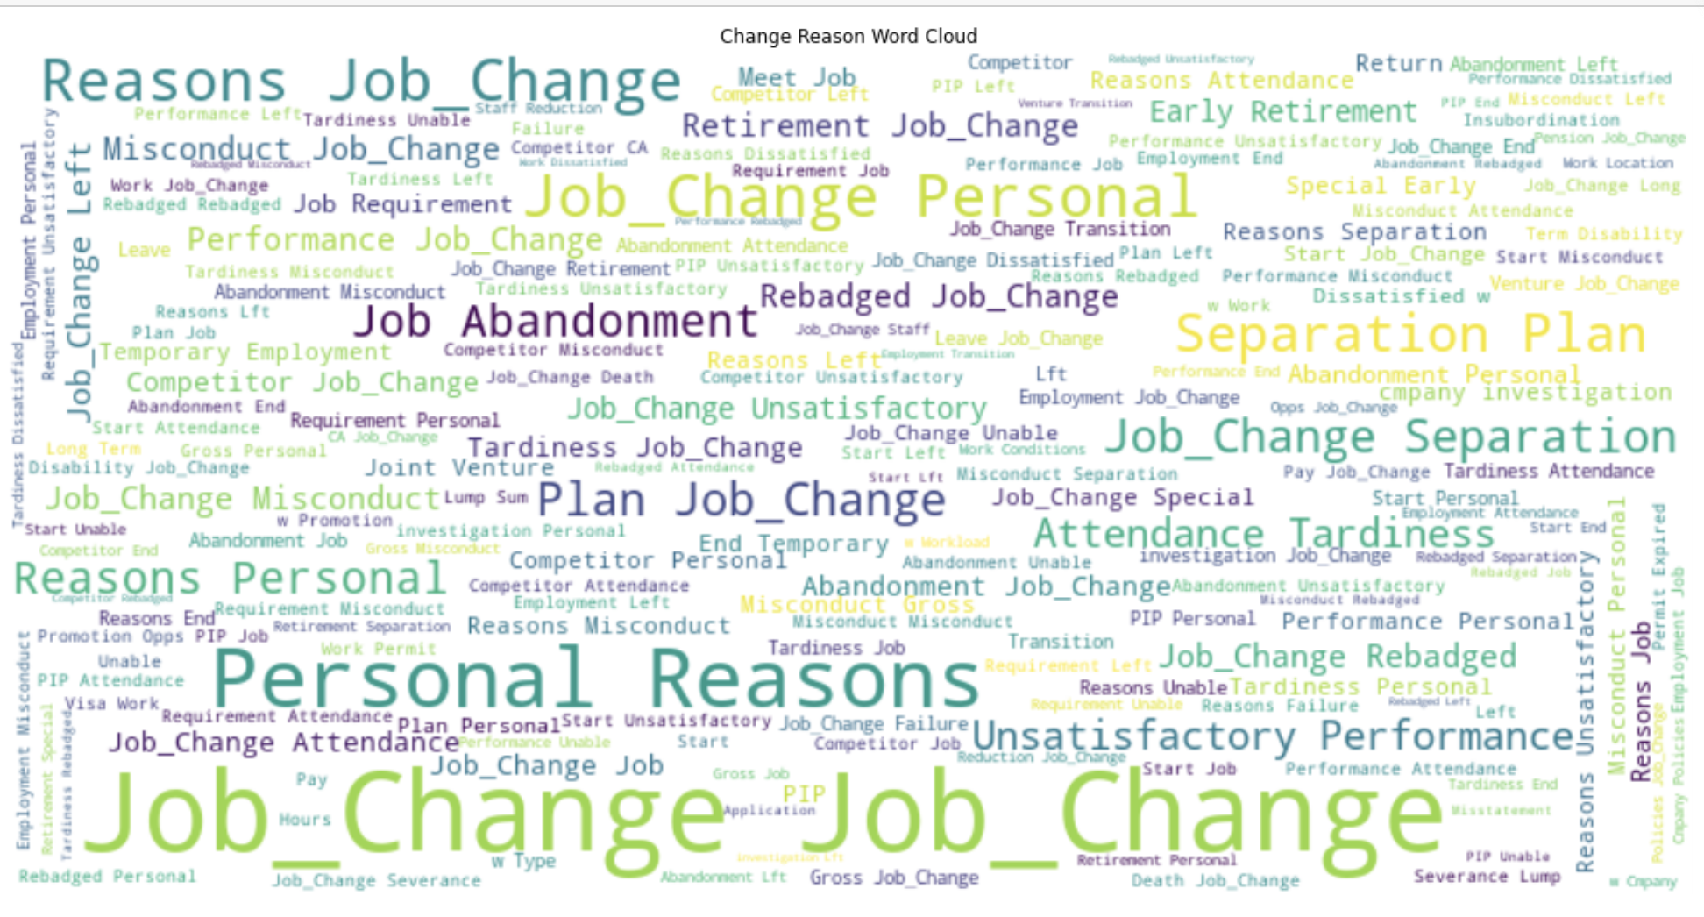
Exploratory Data Analysis
What is the most cited reason for job changes among employees?

Slide 10
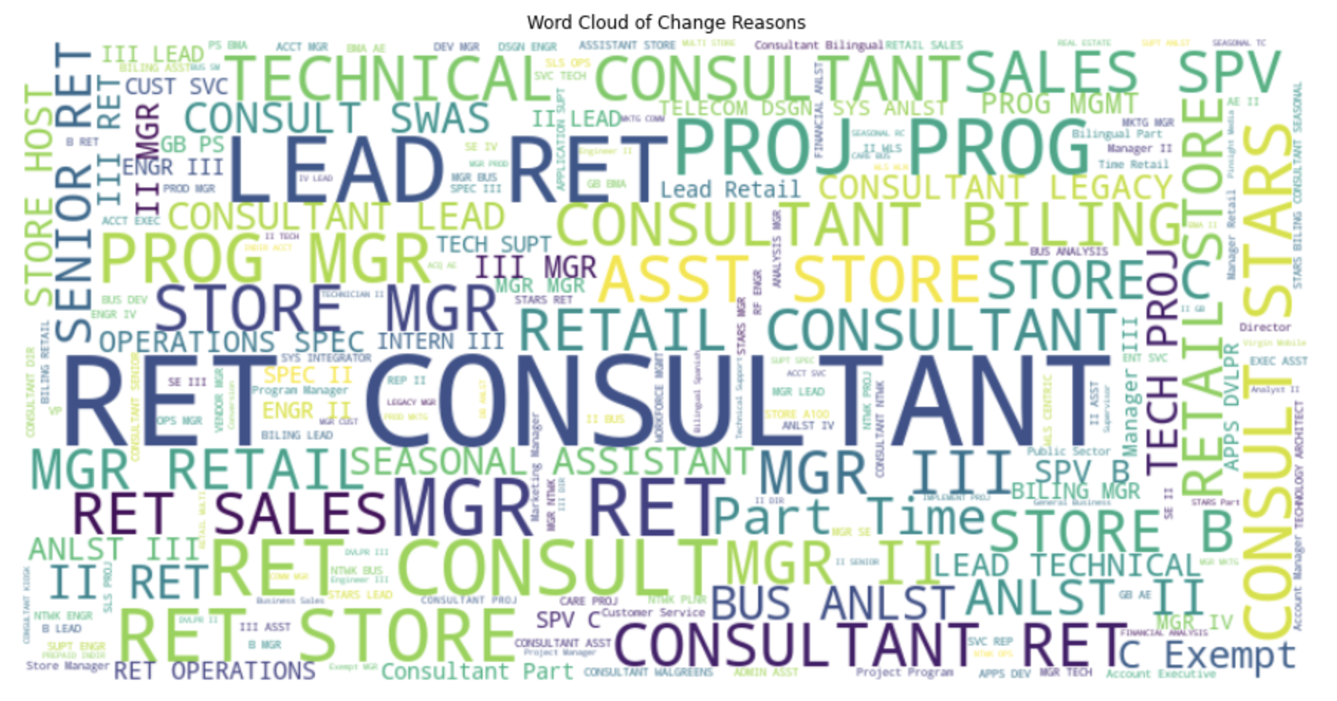
Exploratory Data Analysis
Which profile jobs are posted more frequently?

Slide 11
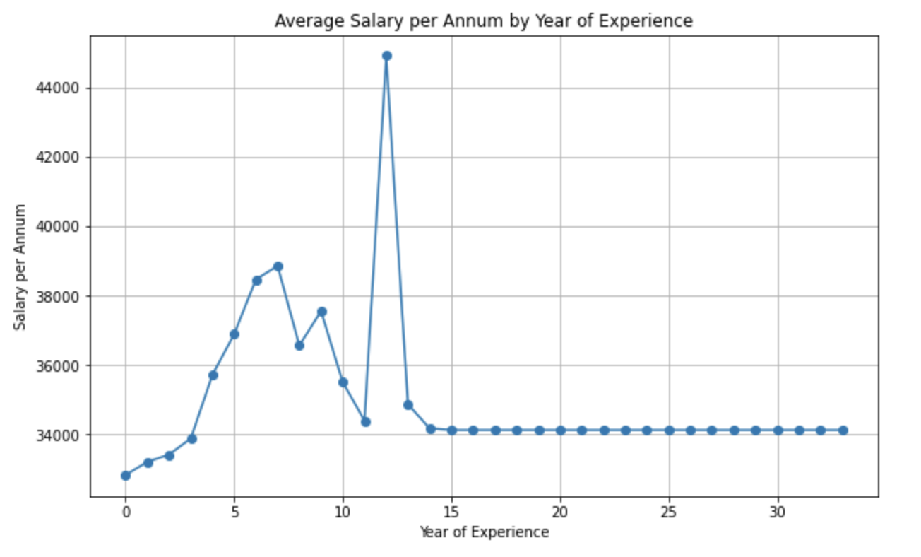
Exploratory Data Analysis
How does the average annual salary vary based on years of experience?

Slide 12
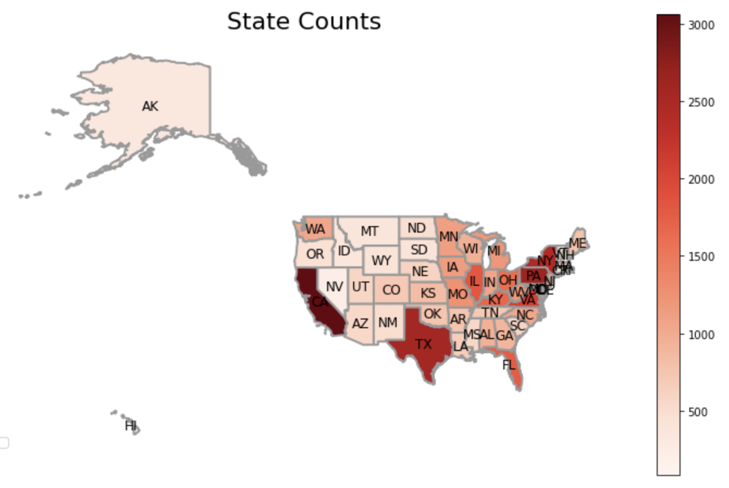
Exploratory Data Analysis - Geospatial vector data
Which cities are the most popular for job seekers in USA?
shapefile: Utilized .shp file that stores the geometric data, such as points, lines, or polygons, representing the spatial features to create this graph.

Slide 13
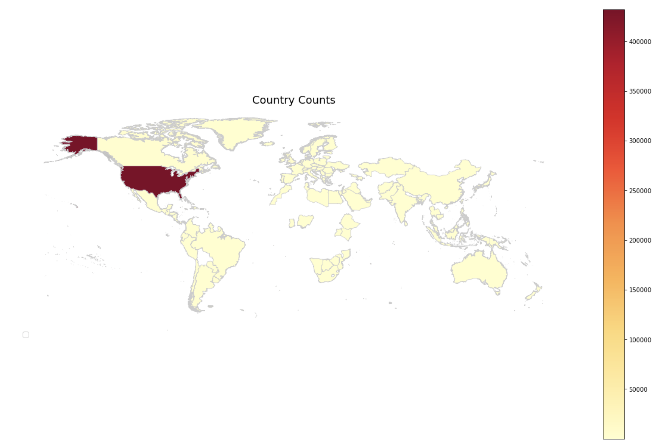
Exploratory Data Analysis - Geospatial vector data
Which countries have the highest job demand within the United States?

Slide 14
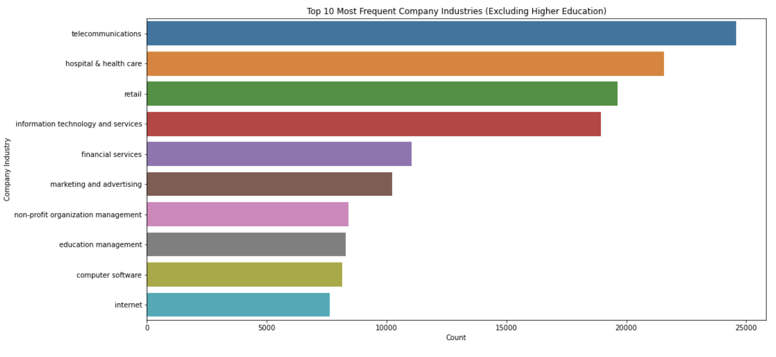
Exploratory Data Analysis
Which Industry/Sector has the most number of Jobs?

Slide 15
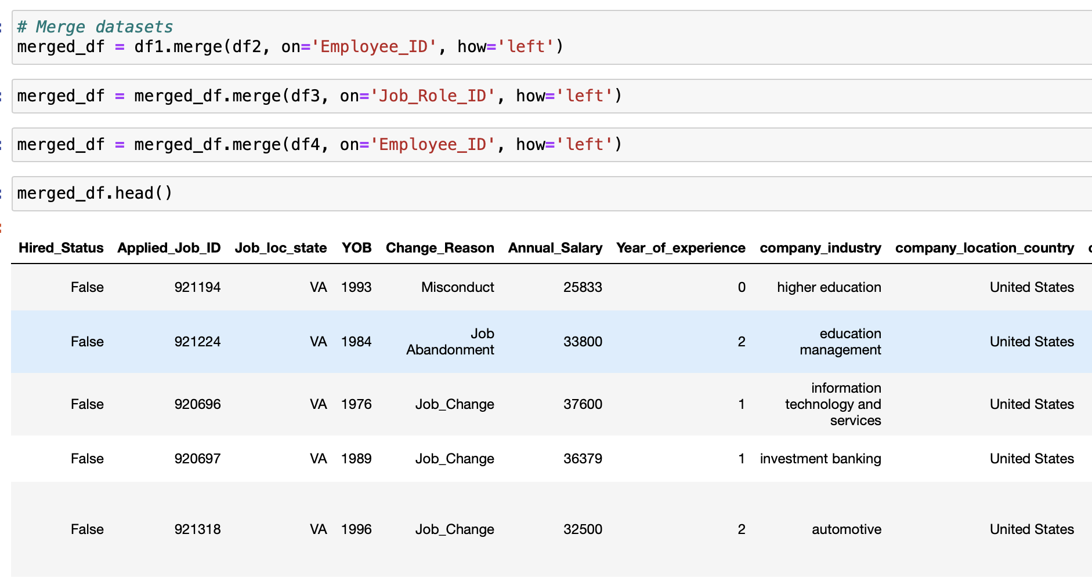
Merge
Methodology Tools and Technology
New merged_df dimension is 379,163 entries and 14 features.
Utilized position start date and End date to create Year of Experience.
Merge all the 4 tables with left join.
Numerical Features: - Year of Experience, Annual Salary, YOB, company_size
Categorical feature: - Job_loc_state, Change_Reason, Company_Industry, Country etc.

Slide 16
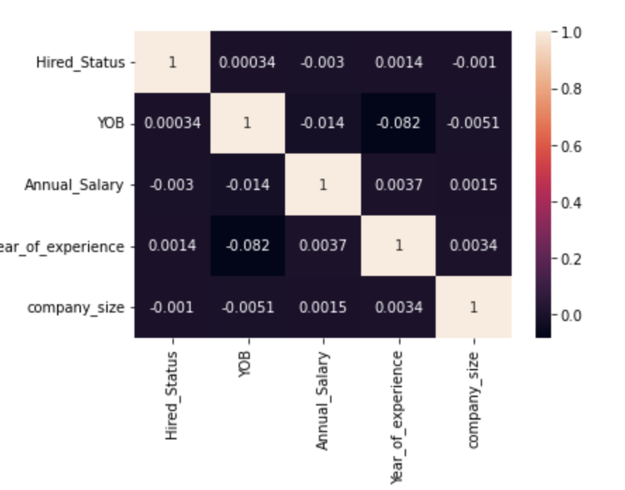
Correlation Matrix
Methodology Tools and Technology

Slide 17
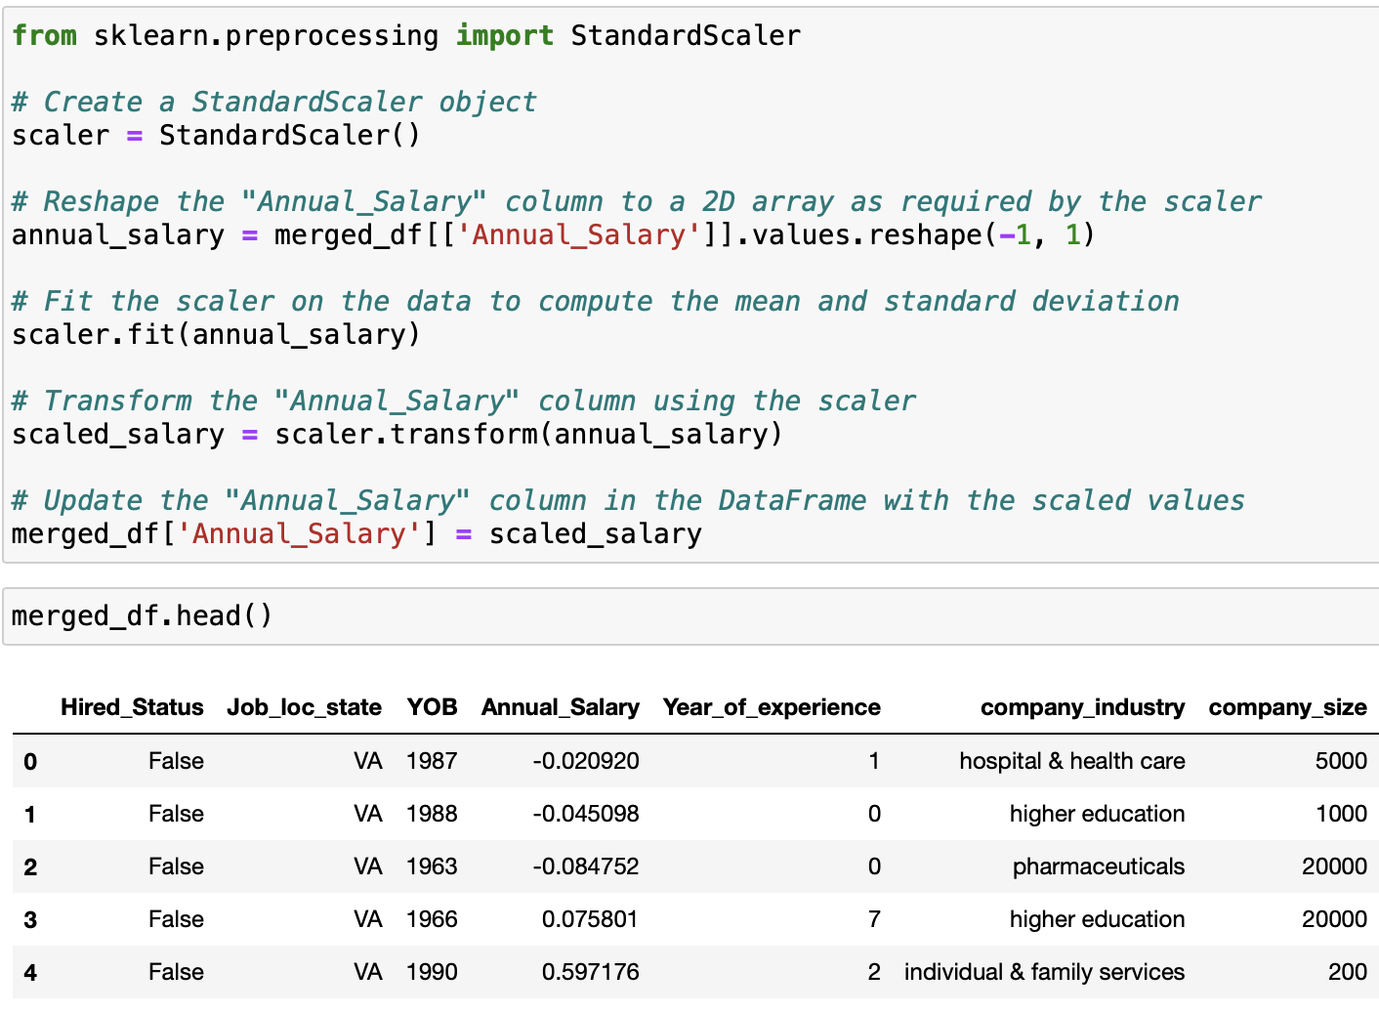
Standardization
Methodology Tools and Technology

Slide 18
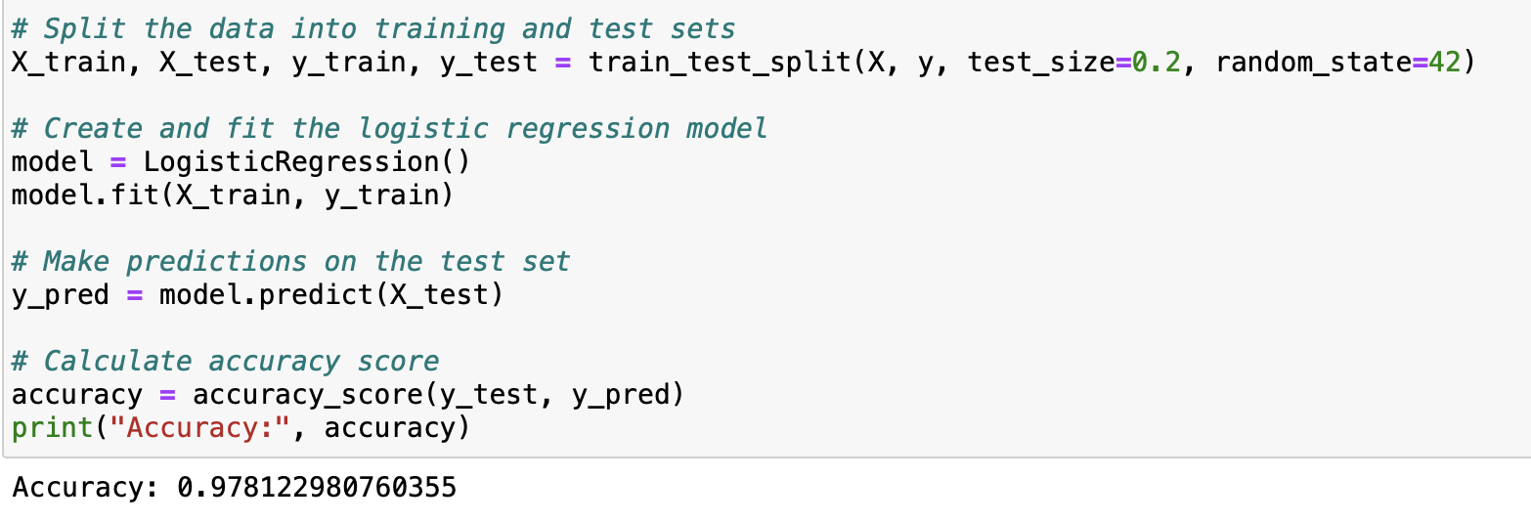
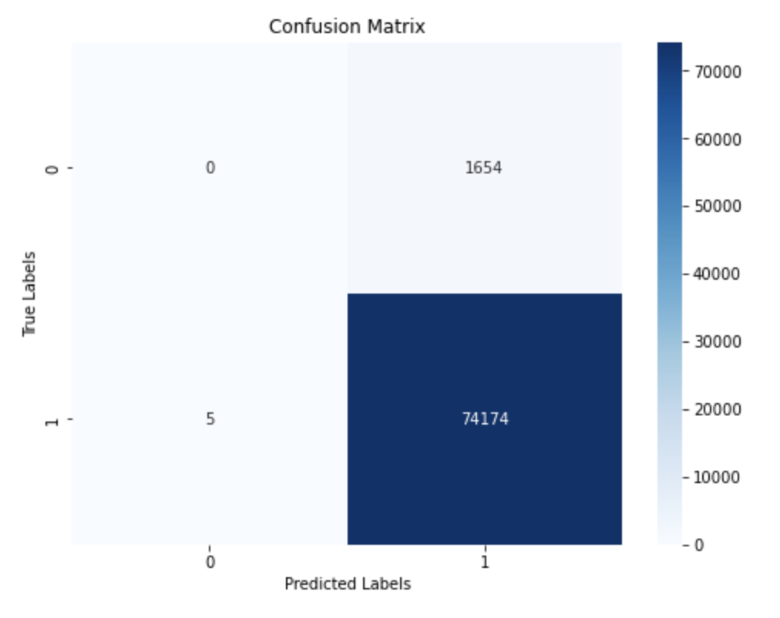
Model Building
Logistic Regression
Accuracy: 97%, which means that it correctly predicts the class of 95% of the instances.
Classification Matrix
The model is very effective in predicting “True” classes but not so effective to predict false classes, due to an imbalanced dataset. For the "True" class (hired), the precision is 0.98, indicating that the model correctly classified 98% of instances predicted as "True" correctly. The support for this class is 74179, indicating a large number of instances for the "True" class in the test set.
MODEL IS BIASED, BECAUSE LESS FALSE IN THE DATASET IMBALANCE DATASET

Slide 19
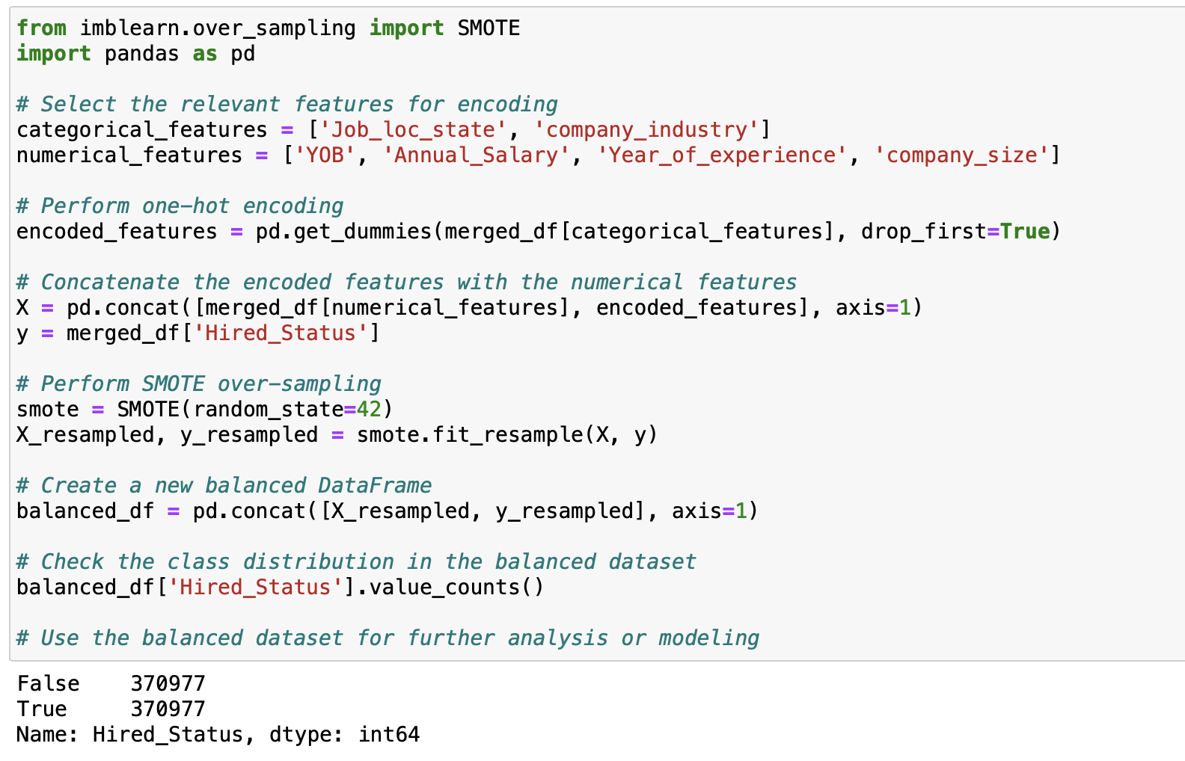
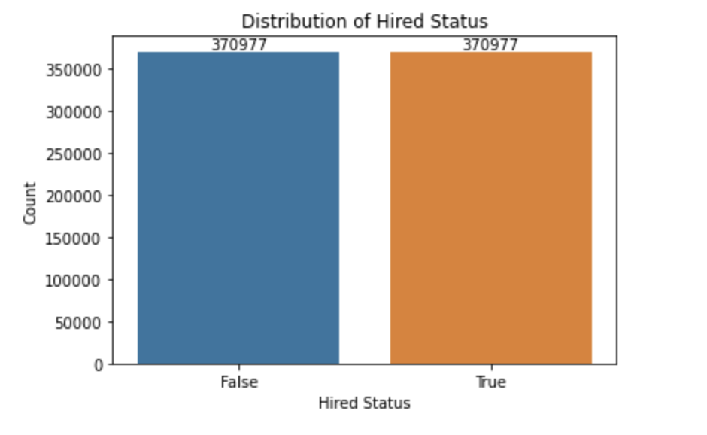
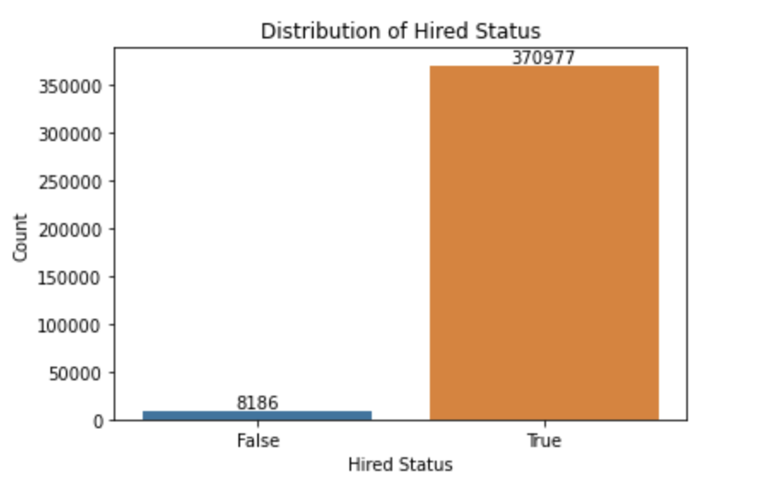
Handling Imbalance Dataset Sampling - SMOTE
Synthetic Minority Oversampling Technique (SMOTE)
Hired Statues | Value Before Sampling | Value After Sampling
True | 370977 | 370977
False | 8186 | 370977

Slide 20
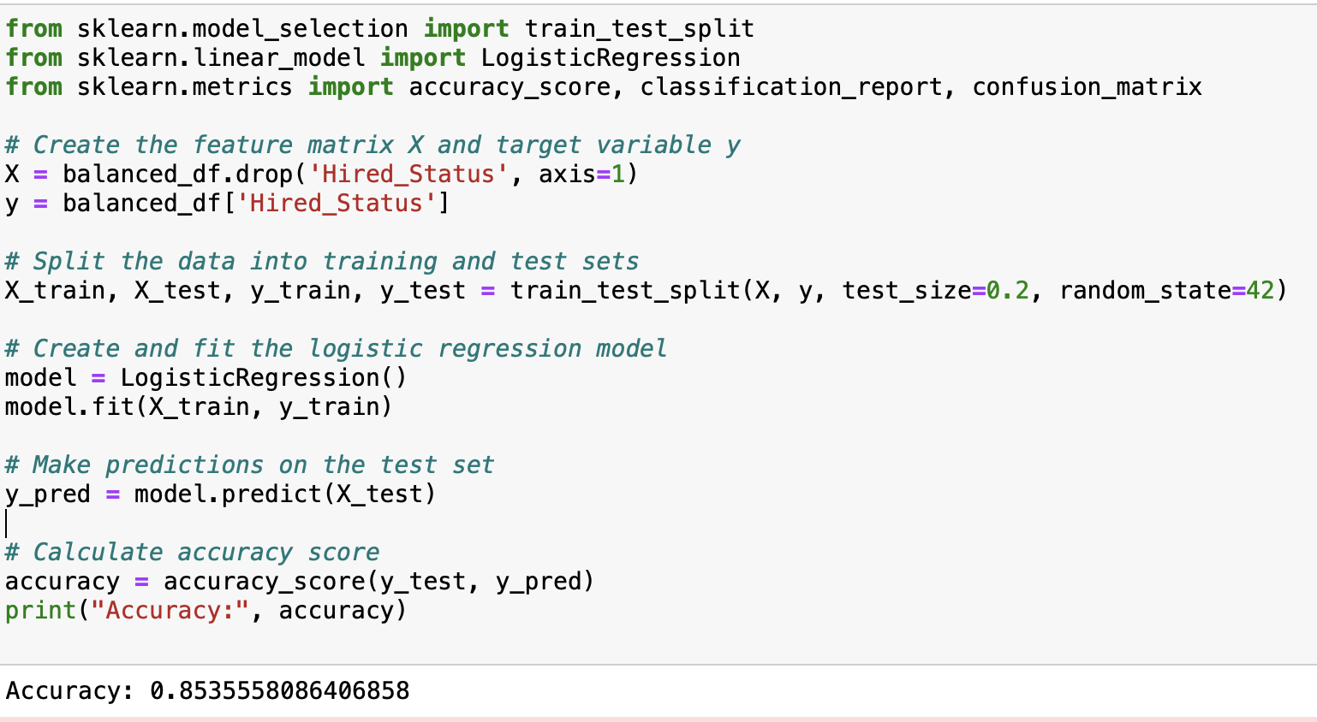
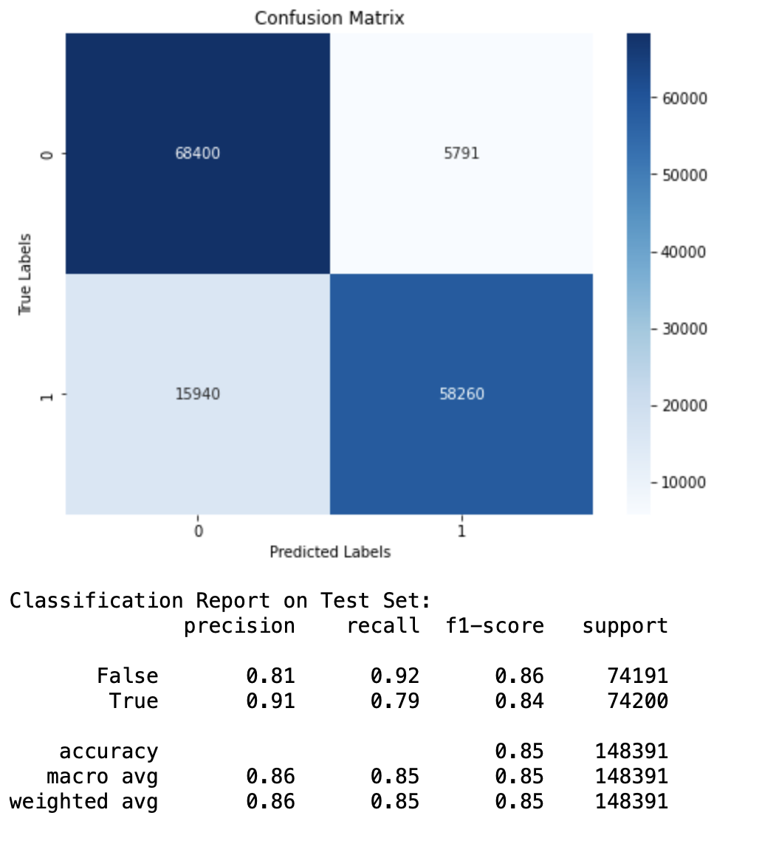
Model Building
Logistic Regression After SMOTE (Sampling)
Accuracy: 85%, which means that it correctly predicts the class of 85% of the instances.
'Job_loc_state', 'company_industry’, YOB', 'Annual_Salary', 'Year_of_experience’ and 'company_size’ are effective in capturing the patterns and relationships in the data, allowing for accurate predictions of the "hired status" variable.
Classification Matrix
Precision: - The precision is 0.81 for false class, i.e., 81% of the predicted "False" instances are actually "False".
For the "True" class, the precision is 0.91, indicating that 91% of the predicted "True" instances are indeed "True".
Recall: - The recall is 0.92 for false class, i.e., the model correctly identifies 92% of the actual "False" instances.
For the "True" class, the recall is 0.79, indicating that the model captures 79% of the actual "True" instances.
F1-score: - For the "False" class, the F1-score is 0.86, and for the "True" class, it is 0.84.

Slide 21
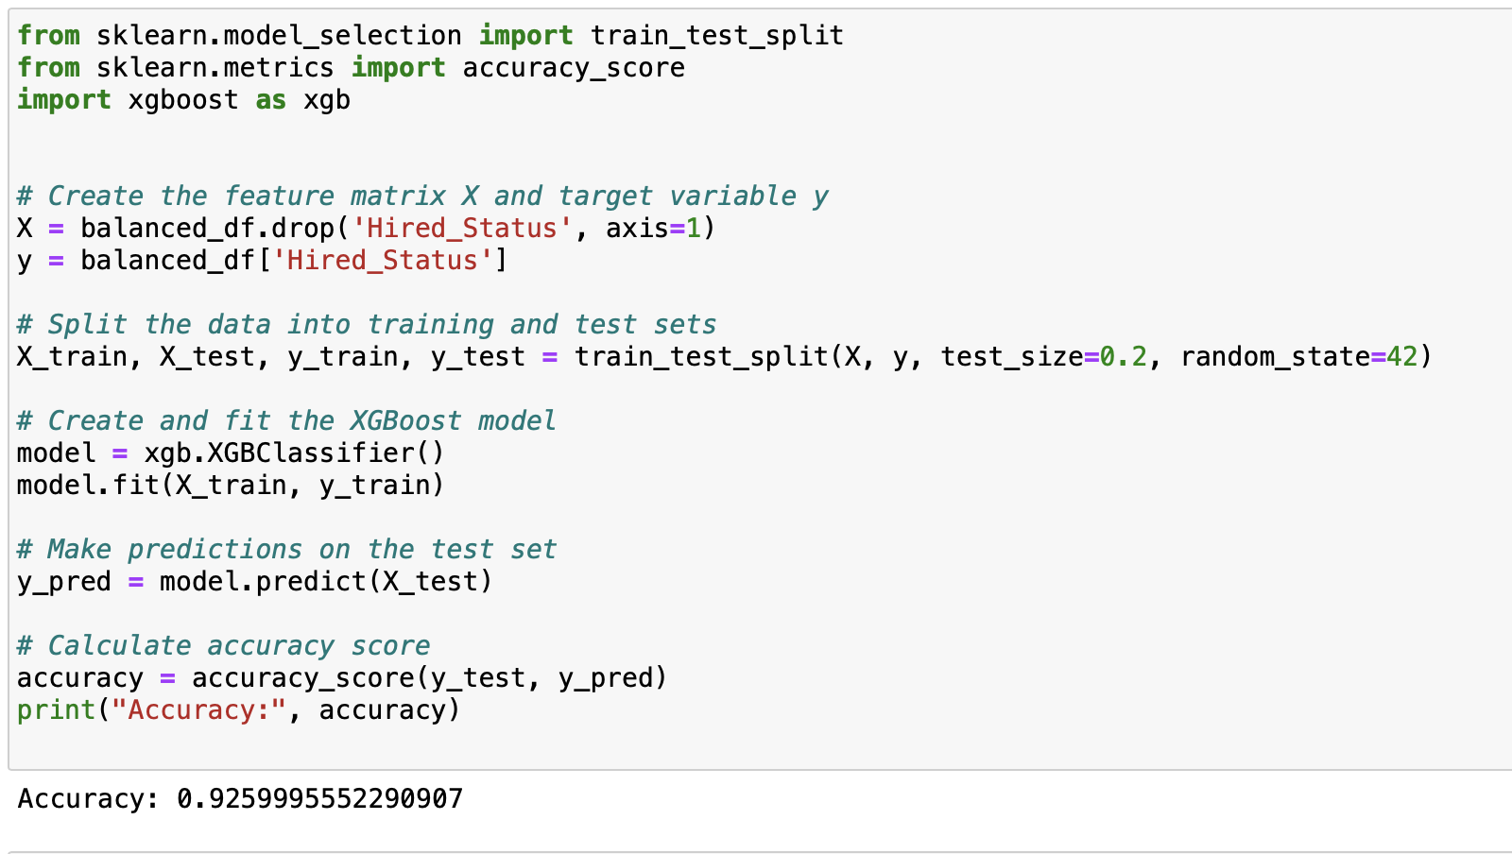
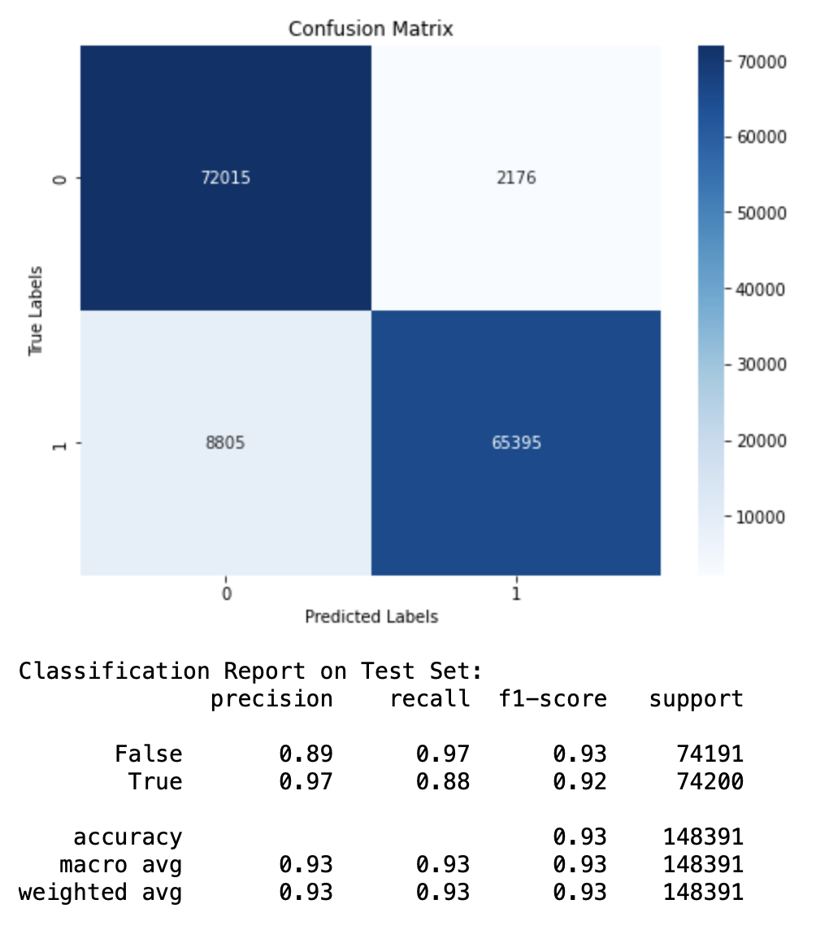
Model Building
XG Boost
Accuracy: 92%, which means that it correctly predicts the class of 92% of the instances, performs better than logistic regression.
Classification Matrix
Precision: - The precision is 0.89 for false class, i.e., 89% of the predicted "False" instances are actually "False".
For the "True" class, the precision is 0.97, indicating that 97% of the predicted "True" instances are indeed "True".
Recall: - The recall is 0.97 for false class, i.e., the model correctly identifies 97% of the actual "False" instances.
For the "True" class, the recall is 0.88, indicating that the model captures 88% of the actual "True" instances.
F1-score: - For the "False" class, the F1-score is 0.93, and for the "True" class, it is 0.92.

Slide 22
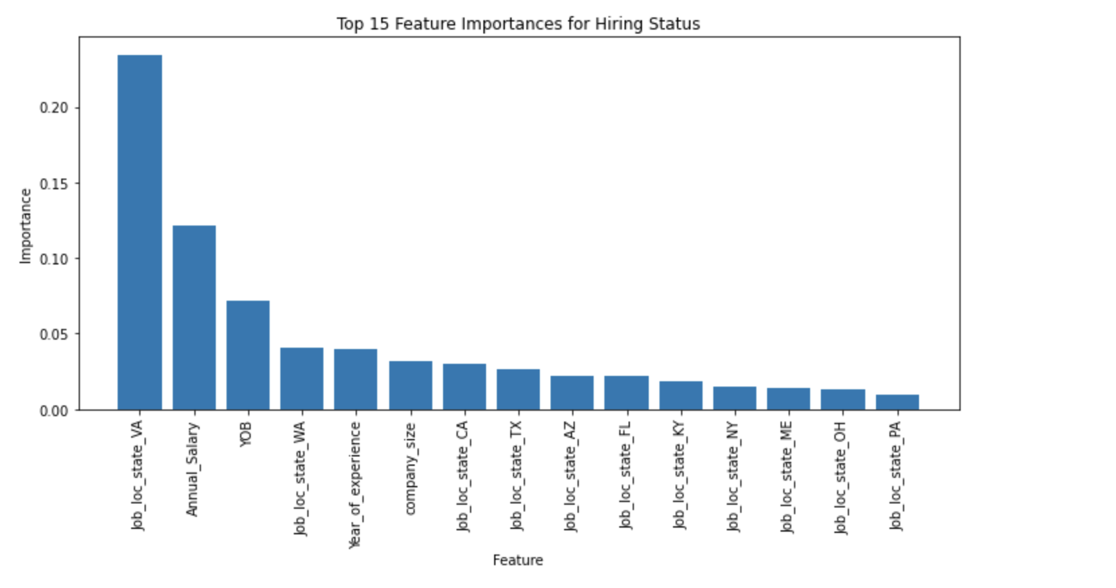
Random Forest
Feature Importance – Numerical Feature
The most influential factors in predicting the hiring status of an employee are annual salary, year of birth (YOB), years of experience, and company size in numerical features and categorical feature of job location state (Job_loc_state) also plays a significant role in determining the hiring status.

Slide 23
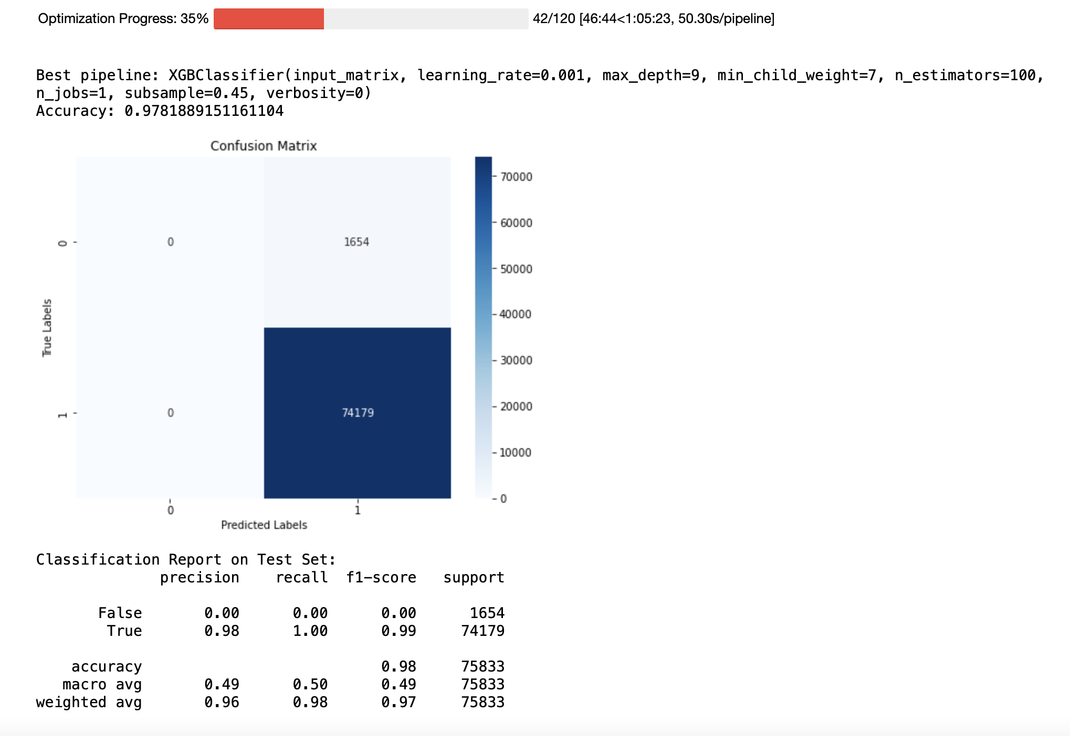

AutoML
XG BOOST is the Winner
AutoML: -
XG Boost Classifier is the best model to solve such talent management problems with the max_depth=9, minimum child weight=7 and learning_rate=0.001.

Slide 24
Conclusion & Future Work
Annual Salary, YOB, Year of Experience, and Company size are the most important numerical features to predict the hiring status and Job_loc_state is one of the top categorical feature.
XG Boost with max_depth=9, minimum child weight=7, and learning_rate=0.001 is the best model to predict the Hiring status of an employee.
AI can significantly improve the candidate selection process by automating high-volume, repetitive tasks and identifying and ranking the best matches between resumes and roles.
Telecommunication and healthcare are the most demanding sectors with the most number of jobs.
Texas, California, New York, and Pennsylvania are the cities most popular for Job seekers.
The United States is the most popular country for Job seeker and have a maximum number of Jobs.
Future Work: -
Utilize other talent management dataset using APIs with more features like skills, University, and Resume. Utilize Deep Learning Techniques and NLP on that dataset.
Leverage K-fold Cross-Validation, and Clustering techniques to handle the imbalance dataset.
Learn more about the business understanding of ATS, HRIS, and Talent Management data and conduct a survey with people analytics/HR analytics professionals to understand more about this field.

Slide 25
REFERENCES
Altamiranda, D. (2022, August 18). Artificial Intelligence in Recruitment and Talent Management. Avature. https://www.avature.net/blogs/artificial-intelligence-in-recruitment-and-talent-management/
AI, E. (2022, January 18). How ai fuels an integrated approach to talent management. Eightfold. https://eightfold.ai/blog/ai-talent-management/
Sydell, E. (2022, April 14). Council Post: Rethinking Talent Management Through AI. Forbes. https://www.forbes.com/sites/forbeshumanresourcescouncil/2022/04/14/rethinking-talent-management-through-ai/
Mastrogiovanni, S. (2021, August 30). AI and the Future of Talent Management | International Association for Human Resources Information Management. International Association for Human Resources Information Management. https://www.ihrim.org/2021/08/ai-and-the-future-of-talent-management-by-sergio-mastrogiovanni/
The Power of AI to Revolutionize Talent Management - Spiceworks. (n.d.). Spiceworks. https://www.spiceworks.com/tech/artificial-intelligence/guest-article/the-power-of-ai-to-revolutionize-talent-management/

Slide 26

THANK YOU

